Slide 1


E - Commerce Prediction and Segmentation
BATCH – PGP DSE Bangalore November 2021
TEAM MEMBERS
Kishalaya Dutta
Ayush Gurjar
Mungara Sai Kalyan Reddy
Ankit Sharma
Priyanka Srivastava
MENTOR - Mrs.Vidya K

Slide 2

Overview
Olist is a small business commerce enabler ecosystem that specializes in the fields of logistics and capital headquartered in Sao Paulo, Brazil. This firm acts as a single point of contact between various small businesses and the customers who wish to buy their products.
The data here is from the years 2017 and 2018, comprising of customers, orders, products, mode of payments, sellers, etc.
The objective of this capstone project is to predict the future sales of the company, optimize their delivery times and help segmenting their customers to improve marketing strategy and increase business operation efficiency.
https://olist.com/pt-br/

Slide 3
Problem Statement
By using exploratory data analysis, we can analyze order times and delivery times of different products in the dataset and then calculate optimal delivery times for better customer satisfaction.
Then using different machine learning algorithms, we can predict future sales of different products of different category.
Using unsupervised machine learning for customer segmentation identifying the potential customers, so that if the company wants to expand in a particular segment they can target that and improve their business.

Slide 4

Datasets
Datasets used:
olist_orders_dataset (order data)
olist_order_items_dataset (order item data)
olist_products_dataset (product data)
olist_order_payments_dataset (payment data)
olist_order_customer_dataset (customer data)
olist_seller_dataset (seller data)
Schema of Brazilian Olist E-Commerce Dataset

Slide 5
Data Dictionary
Columns Name | Datatype
order_id | object
customer_id | object
order_status | object
order_purchase_timestamp | datetime64
order_approved_at | object
order_delivered_carrier_date | datetime64
order_delivered_customer_date | datetime64
order_estimated_delivery_date | datetime64
product_id | object
order_item_id | int64
product_width_cm | float64
seller_id | object
shipping_limit_date | object
price | float64
freight_value | float64
product_category_name | object
product_name_lenght | float64
product_description_lenght | float64
product_photos_qty | float64
product_weight_g | float64
product_length_cm | float64
product_height_cm | float64
Columns Name | Datatype
recency | int64
frequency | int64
Total Price | int64
Count of Categorical Data type: 8 Count of Datetime Data type: 4 Count of Numeric Data type: 18

Slide 6
Exploratory Data Analysis
In the coming slides we will see the graphical representations of the analysis we did.
Bar plots, count plots and pie charts are some of the medium that have been used to visualize our findings.
We have also written inferences from the plots which are plotted.

Slide 7
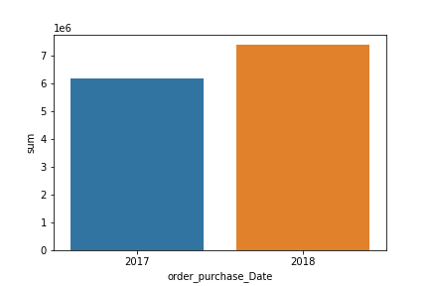
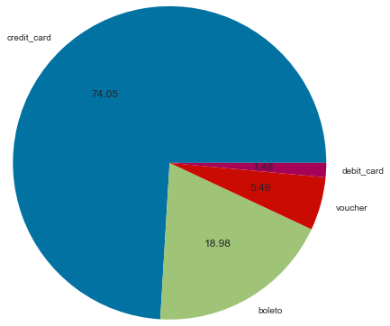
2018 generated more revenue than 2017
The revenue generated in 2017 is 6155806.98 Brazilian Reals whereas in 2018 is 7386050.80 Brazilian Reals, an increase by 1230243.81 Brazilian Reals
Online mode is the most popular mode of payment
Credit card used by 74 % users for payment
Debit card used only by 2% users
.

Slide 8
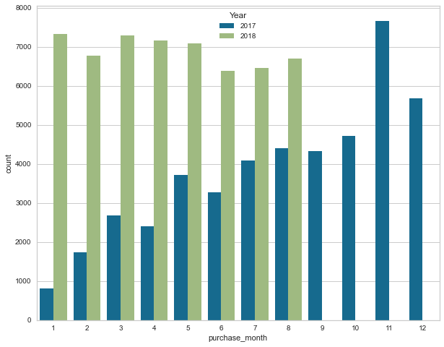
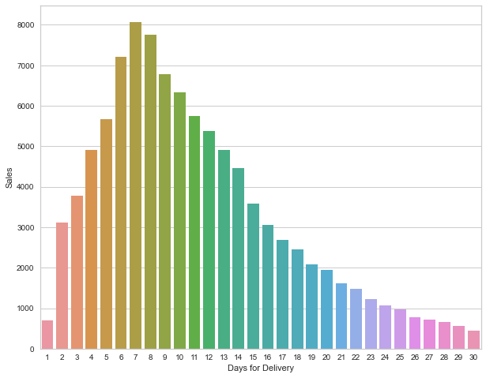
From the Monthly Sales chart most sales happened in 2017 November and least sales happened in 2017 January
Most no of sales are happening when the average delivery days are around 7-8 days

Slide 9
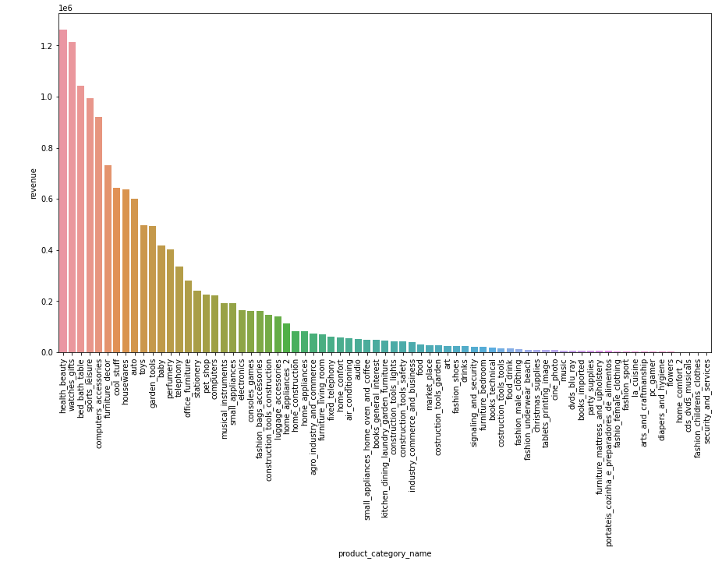
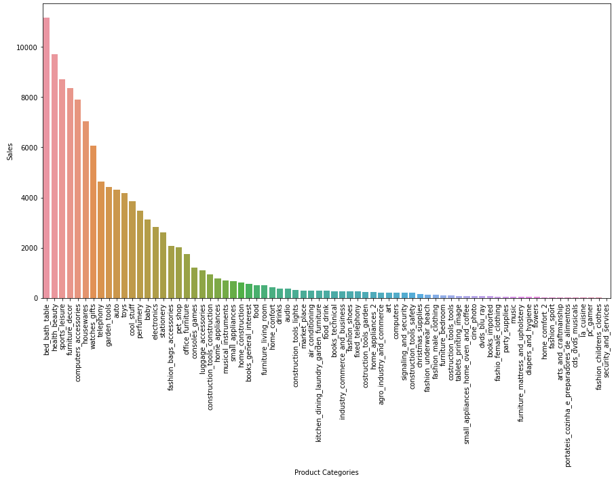
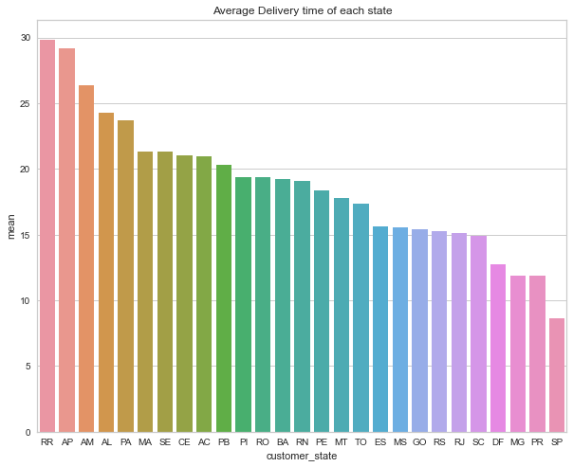
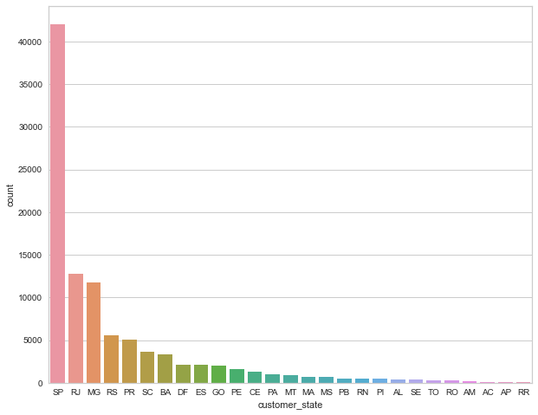
1
2
Health and Beauty category generates highest revenue
Security and Services category generates lowest revenue
Bed, Bath and Table category was the highest selling
Security and Services category was the lowest selling
3
4
RR (Roraima) state average delivery time of any product category is more
SP (Sao Paulo) state average delivery time of any product category is less
SP (Sao Paulo) generates the highest sales with least delivery time
RR (Roraima ) has highest delivery time generates the least sales count.

Slide 10
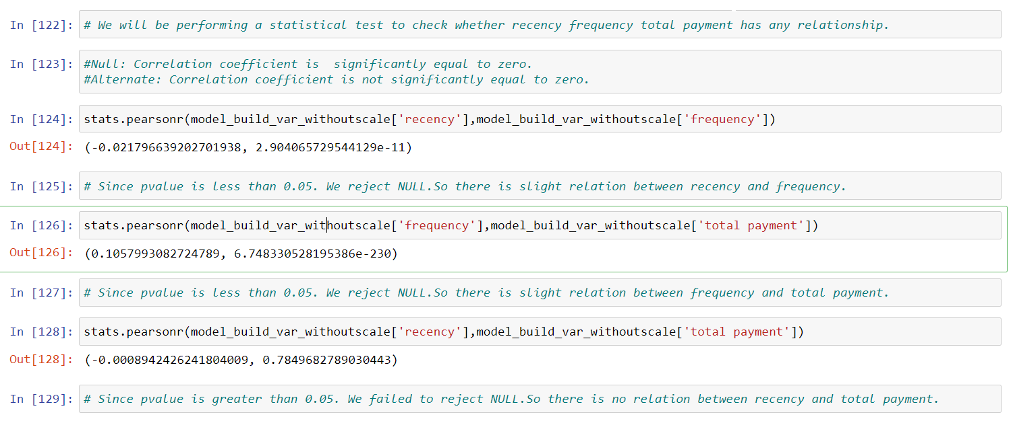
Statistical Analysis
We have calculated the Pearson Correlation Coefficient on Recency and Frequency, Frequency and Total Payment, Recency and Total Payment.
Since the p-value < 0.05, we reject the null hypothesis for the first two tests implying slight correlation between the variables.
For the last test, the p-value > 0.05, we fail to reject the null hypothesis and conclude that there is no correlation between the variables.

Slide 11
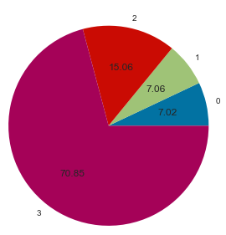
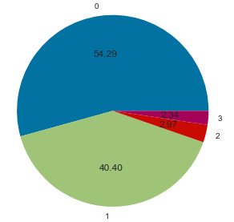
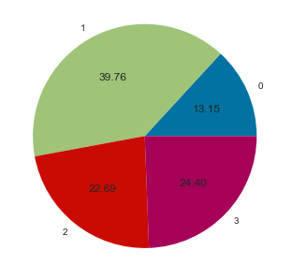
Customer Segmentation Using K-Means Clustering
Revenue From Each Cluster
Customers Per Cluster
Recency of Customers Per Cluster
Cluster 3 generated highest revenue
Cluster 0 generated lowest revenue
Cluster 0 has the highest customer base
Cluster 3 has the lowest customer base
Cluster 0 has highest order recency
Cluster 1 has lowest order recency

Slide 12
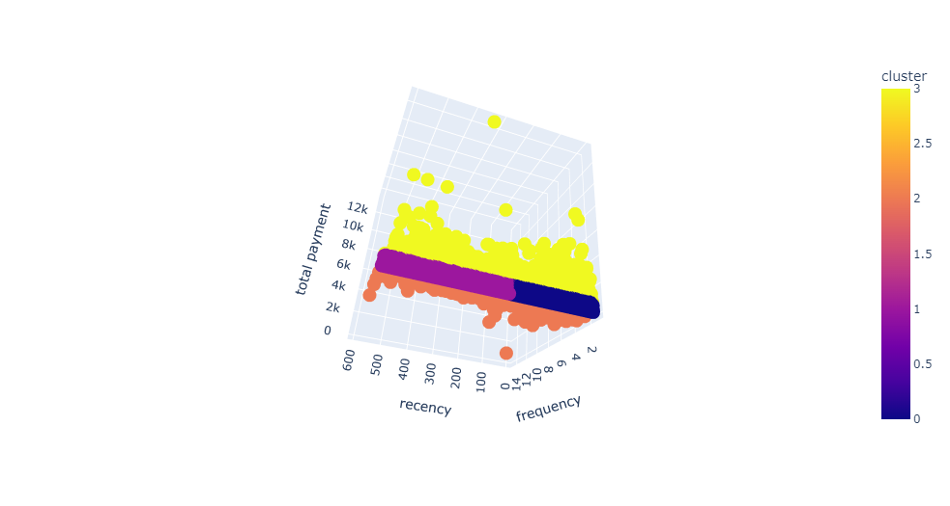
3-D Representation of Clustering

Slide 13
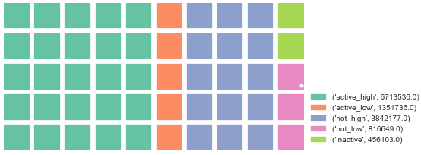
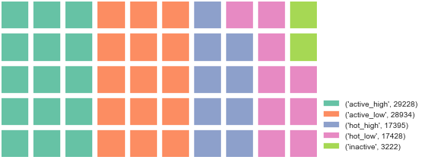
Segmenting Customers By RFM Analysis
Revenue By Sub-Segment
Orders By Sub-Segment
Active High Customers are spending more
Inactive Customers are spending less
Active Customers ordered the highest
Inactive Customers ordered the lowest

Slide 14
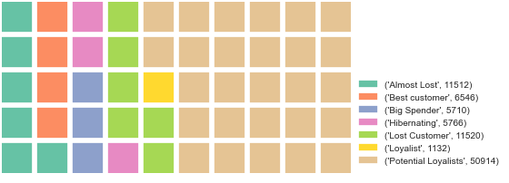
Strategies To Improve Customer Experience
Customer RFM Segment
Strategy
Customer RFM Segment | Strategy
Almost Lost | Try to win them with limited sales promotions
Best Customer | Personalized communication, offer loyalty program, no promotional offers needed
Big Spender | Make them feel valued and offer quality products, encourage to stick with brands
Hibernating | Make great offers with big discounts
Lost Customer | Do not spent much effort and money to win them
Loyalist | Offer loyalty rewards and programs
Potential Loyalists | Recommend products and offer discounts

Slide 15
Thank You

